Slide 1
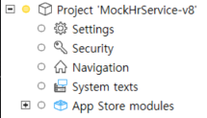
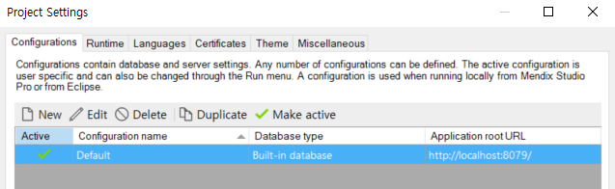
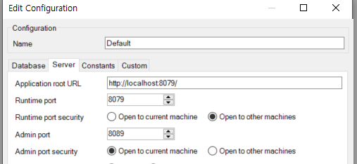
MockHrService
MockHrService
Package Import
Service Port 확인

Slide 2
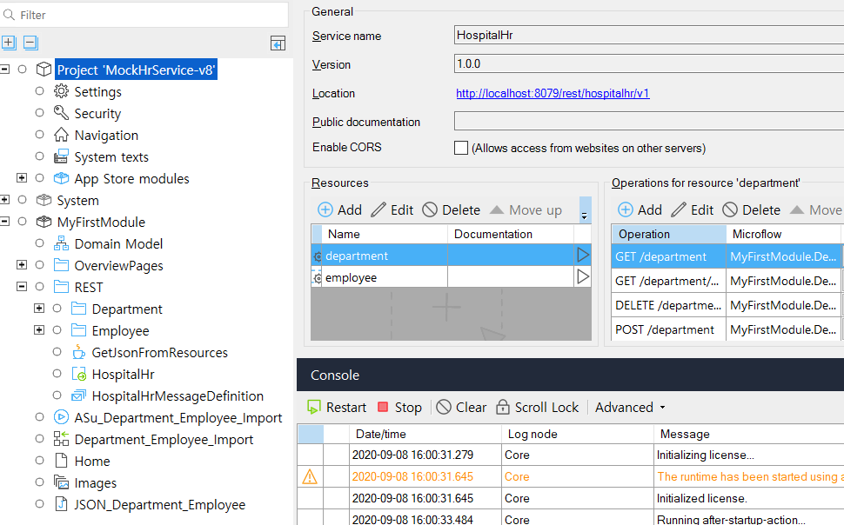
MockHrService
MockHrService 실행
Rest Api Service에서 get 서비스 호출
http://localhost:8079/rest-doc/rest/hospitalhr/v1#/department/get_department
2
1

Slide 3
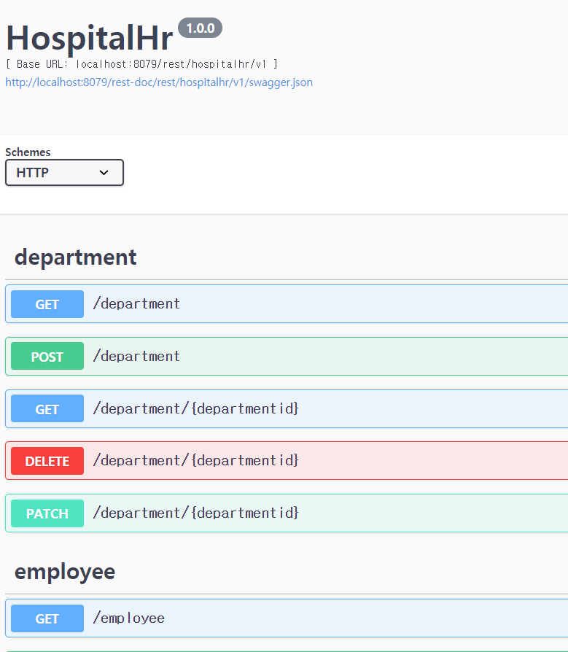
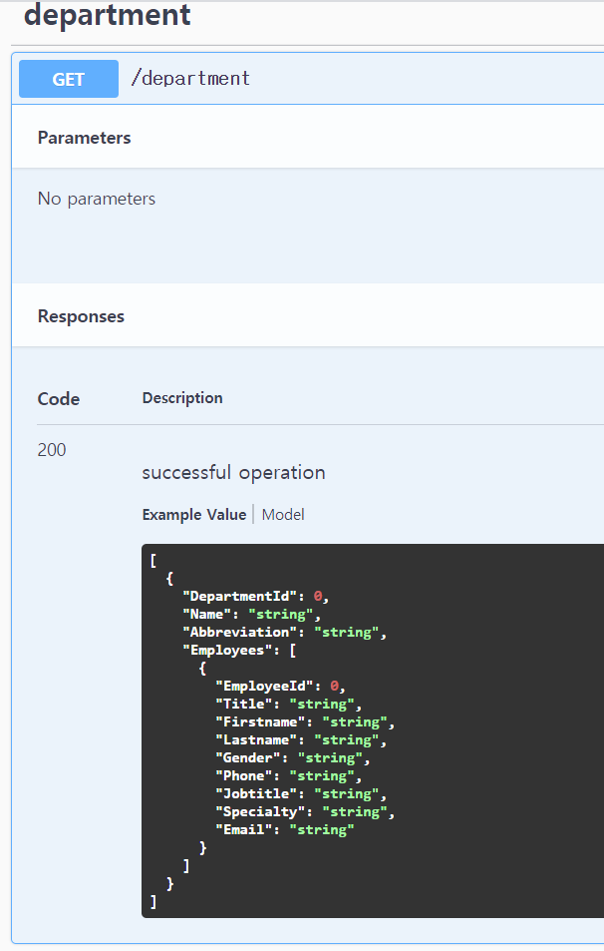
Mock
[
{
"DepartmentId": 0,
"Name": "string",
"Abbreviation": "string",
"Employees": [
{
"EmployeeId": 0,
"Title": "string",
"Firstname": "string",
"Lastname": "string",
"Gender": "string",
"Phone": "string",
"Jobtitle": "string",
"Specialty": "string",
"Email": "string"
}
]
}
]
MockHrService 실행
Rest Api Service에서 get 서비스 호출
http://localhost:8079/rest-doc/rest/hospitalhr/v1#/department/get_department
2
1

Slide 4
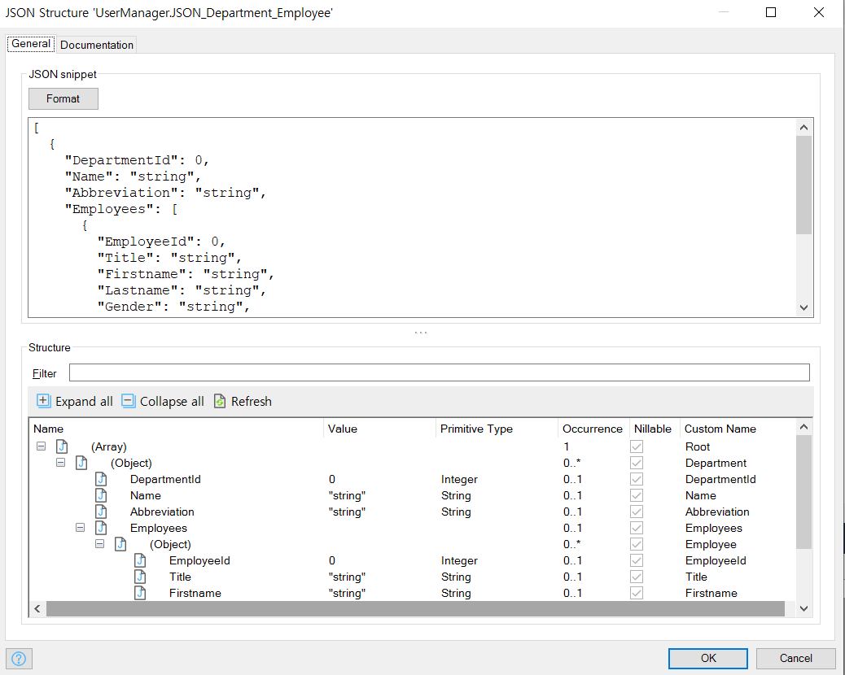
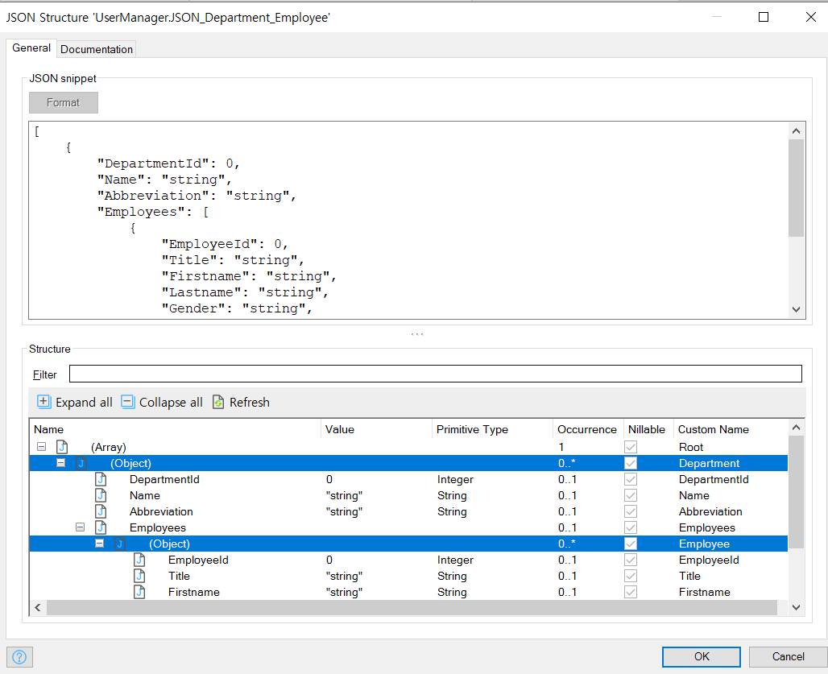
JSON Structure 생성
JSON_Department_Employee
1
2
Rename
Rename

Slide 5
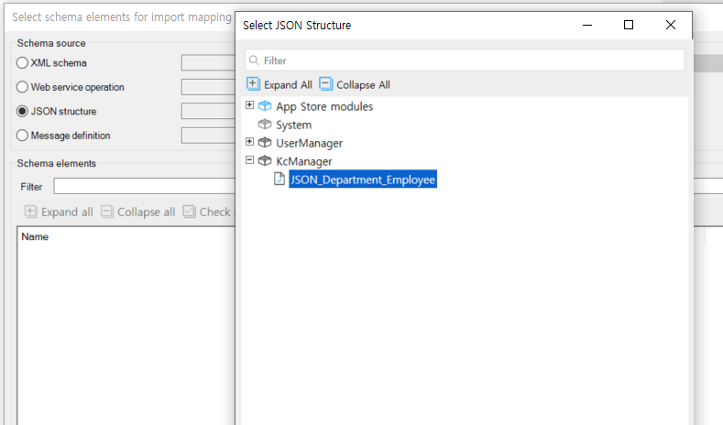
Import Mapping 생성
ImM_Department_Employee

Slide 6
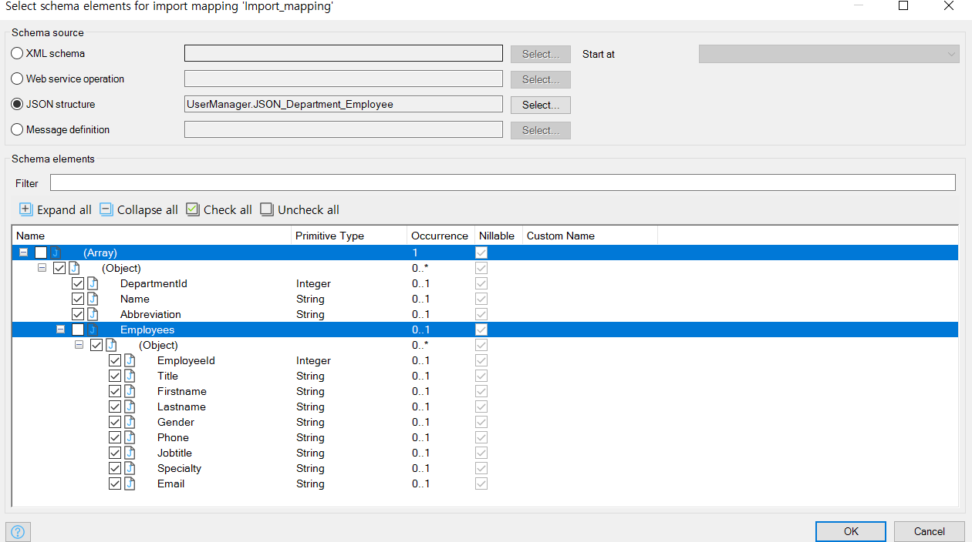
Import Mapping 생성
ImM_Department_Employee
1
2
Un-check
Un-check

Slide 7
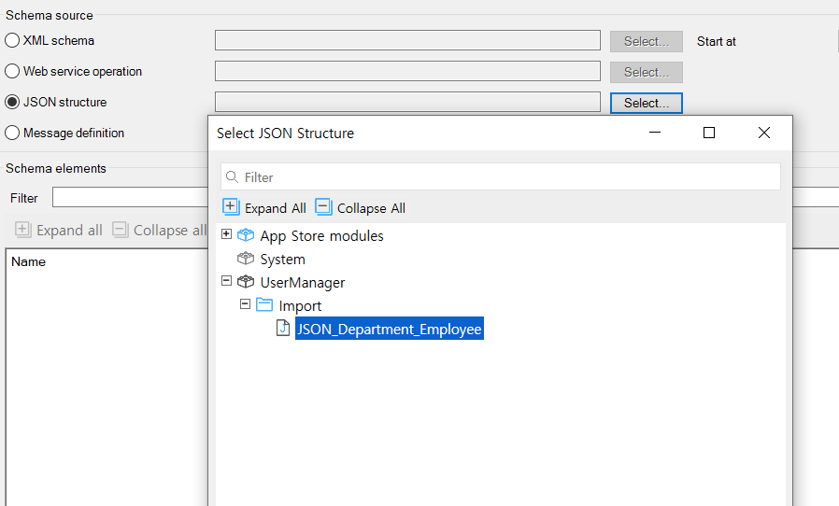
ImportMap 생성
ImM_Department_Employee
1
Uncheck
Uncheck

Slide 8
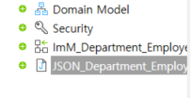
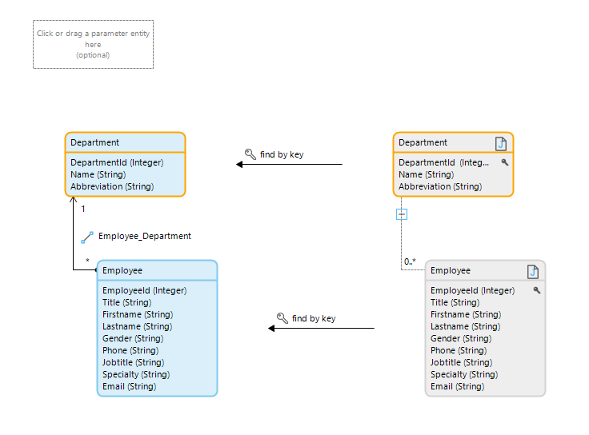
ImportMap 생성
ImM_Department_Employee
3
1
2

Slide 9
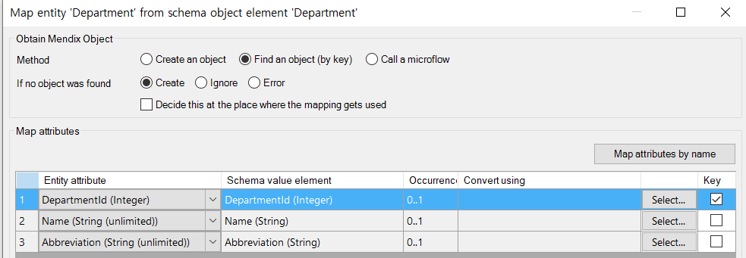
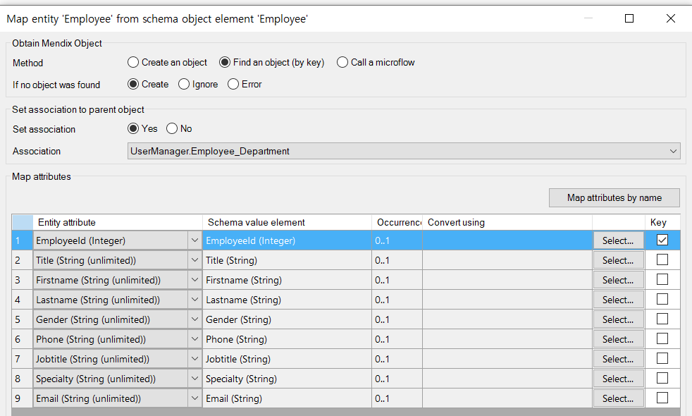
Find by key
Find by key 정의
Department와 Employee의 Find by key 정의
1
2

Slide 10
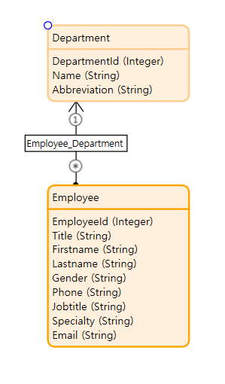
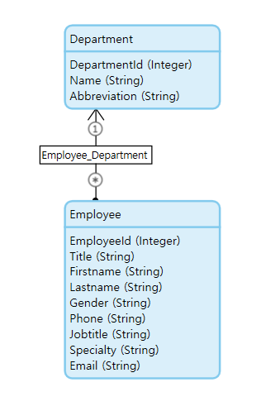
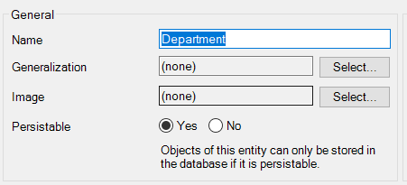
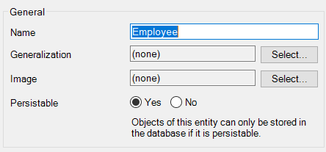
Model Object Status Change
- Persistable Domain Model

Slide 11
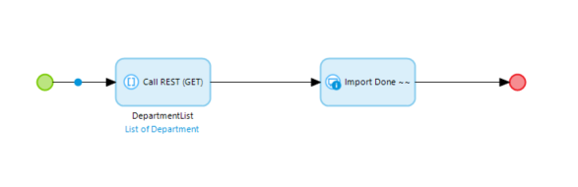
Create Micro Flow
ACT_Dept_Emp_Imp

Slide 12
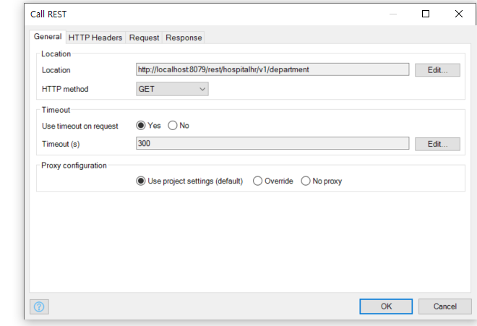
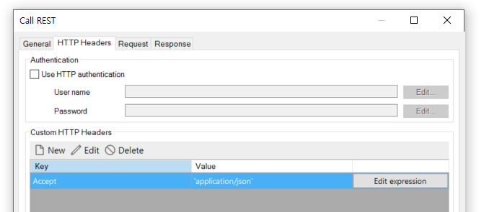

http://localhost:8079/rest/hospitalhr/v1/department
Accept
'application/json'

Slide 13
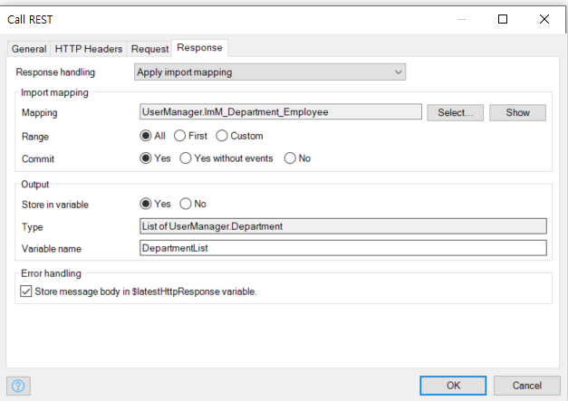

Slide 14
